Slide 1
TO PERC OR NOT TO PERC
WEDNESDAY 6TH OCTOBER 2021

Slide 2


Slide 3
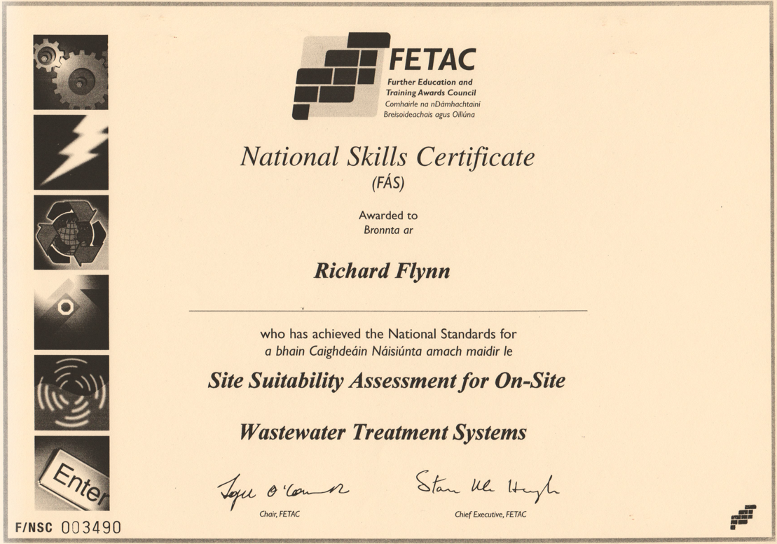

Slide 4
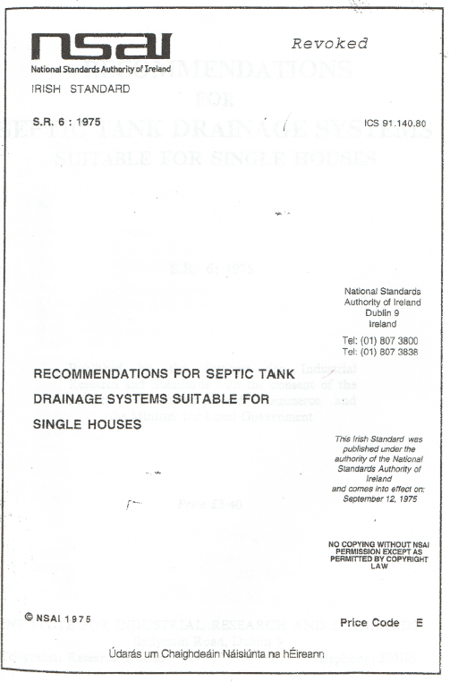

Slide 5
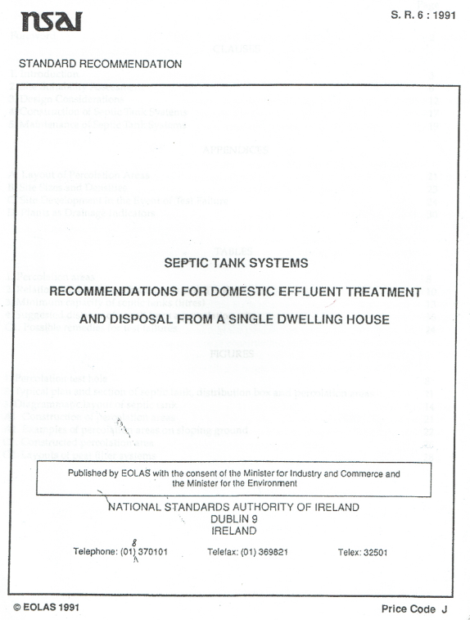

Slide 6
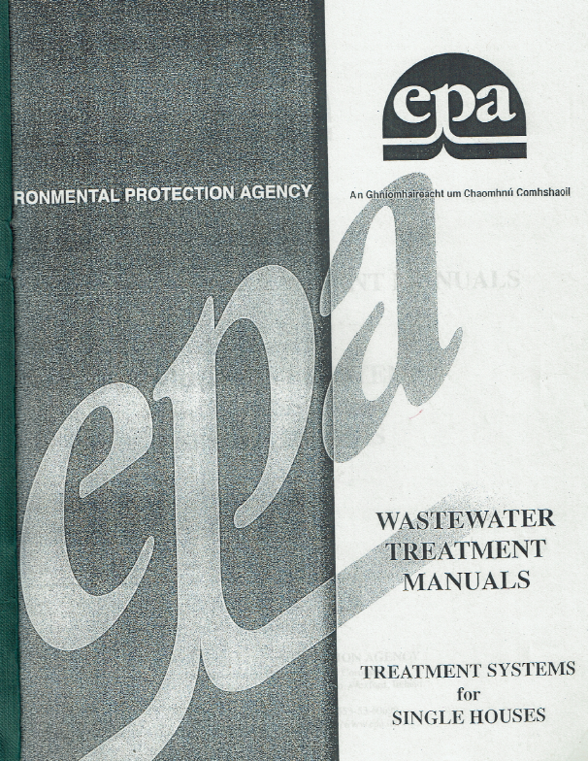

Slide 7
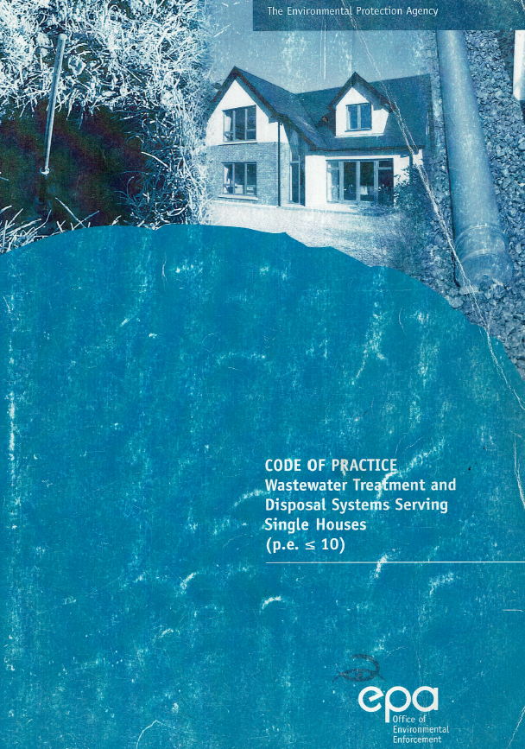

Slide 8


Slide 9
COMMON THEME
TRIAL HOLE ASSESSMENT + PERCOLATION TEST

Slide 10
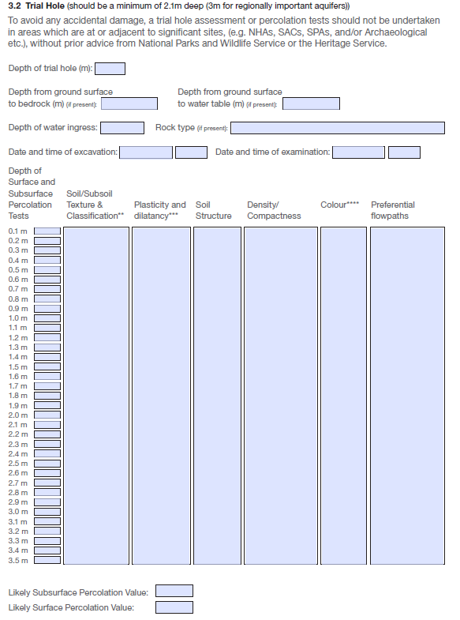

Slide 11
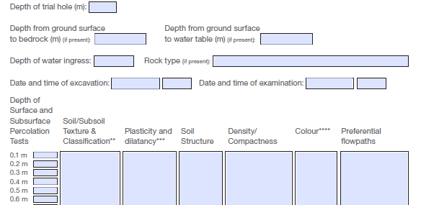

Slide 12
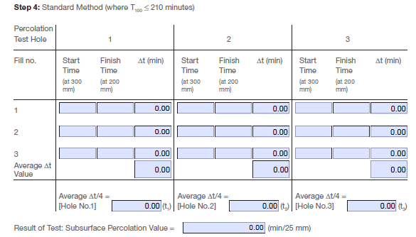

Slide 13
PERCOLATION VALUE (min/25mm)
PERCOLATION VALUE OF 50min/25mm
= 12 Hours on Site

Slide 14
ETC PASK (CONSTANT HEAD WELL)
PERMEAMETER FOR IN-SITU
MEASUREMENT OF FIELD SATURATED
HYDRAULIC CONDUCTIVITY OF SOILS

Slide 15
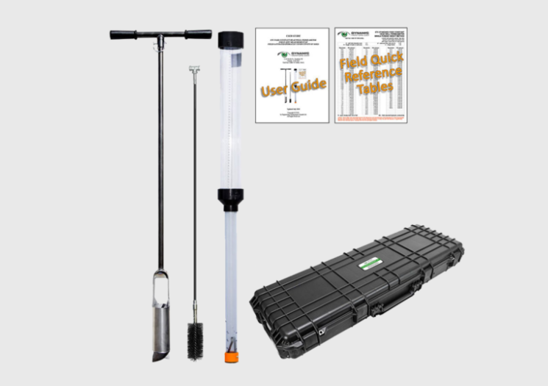

Slide 16
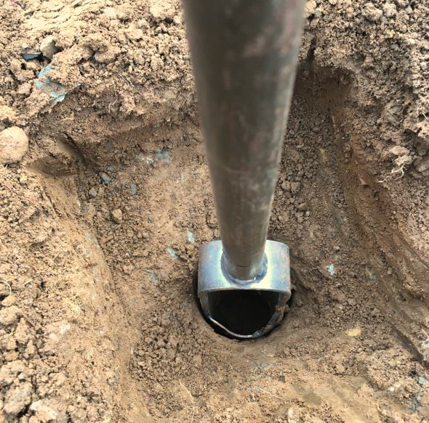

Slide 17
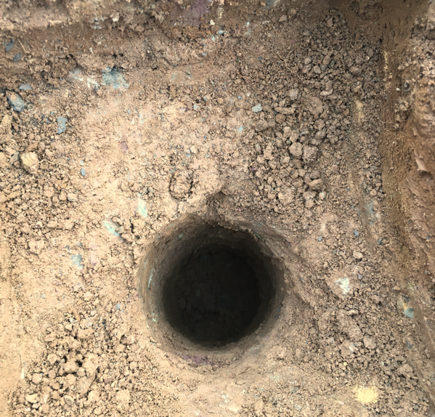

Slide 18
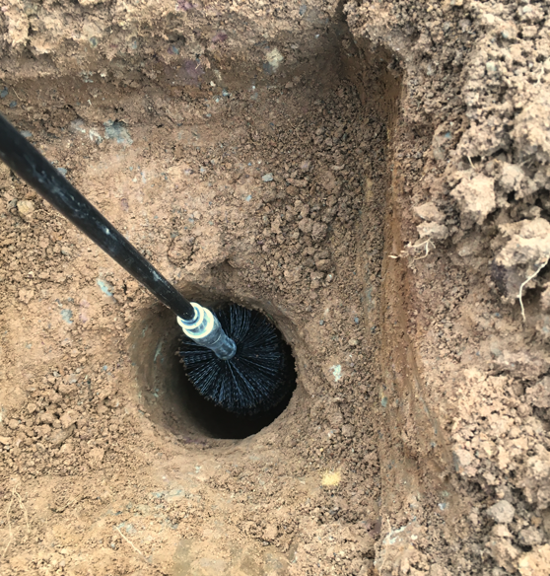

Slide 19
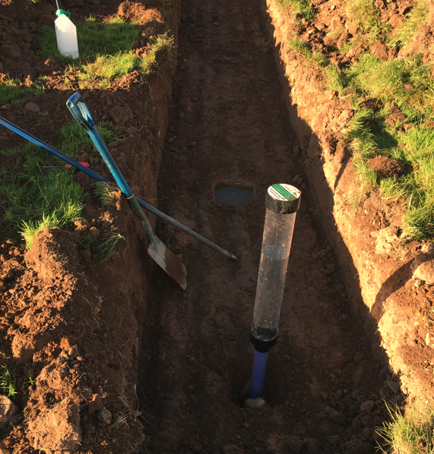

Slide 20
Thank you for your time.

